Slide 1
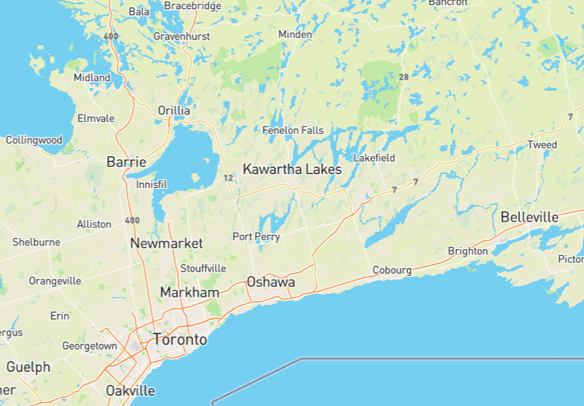
Land acknowledgement
As we gather, we acknowledge that the area we know as the Diocese of Toronto is also the traditional territory…

Slide 2
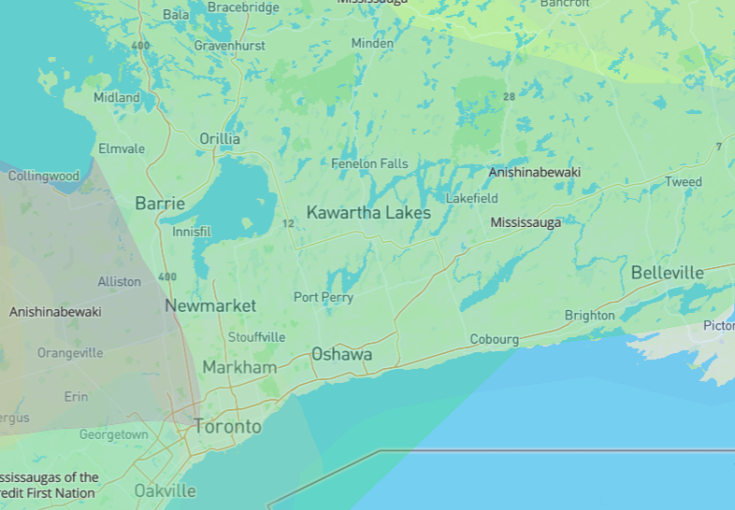
Land acknowledgement
of the Anishnaabe,

Slide 3
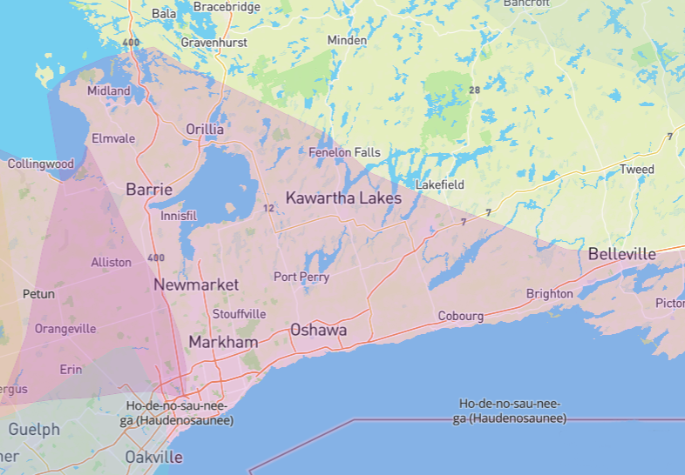
Land acknowledgement
the Haudenosaunee,

Slide 4
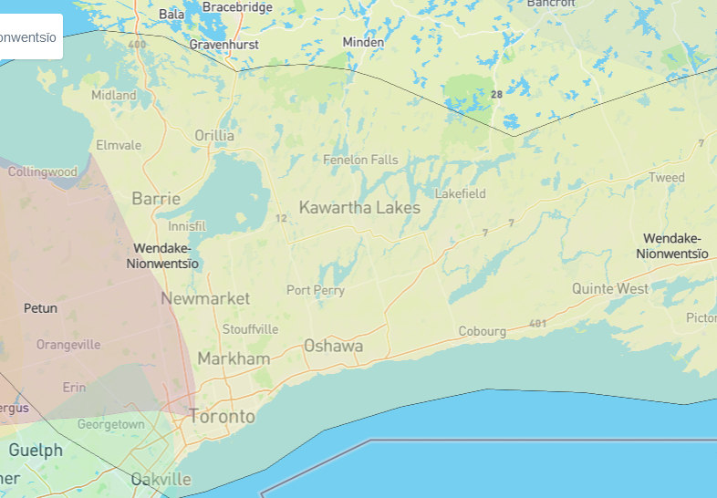
Land acknowledgement
and the Wendat.

Slide 5
Land acknowledgement
This land is also the subject of the Dish with One Spoon Wampum Belt Covenant, an agreement between the Haudenosaunee and the Anishnaabe to share and care peaceably for the resources around the Great Lakes.

Slide 6
Land acknowledgement
We give thanks for the stewardship of this land by Indigenous people, and the continuing presence here of First Nations, Métis and Inuit from across Turtle Island.

Slide 7
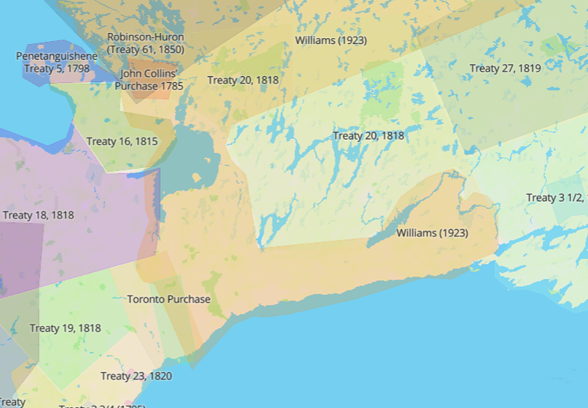
Land acknowledgement
We acknowledge the displacement of First Nations people to reserves by a series of treaties, the harm caused by colonialism, and the role our Church has played in it.

Slide 8
Land acknowledgement
We acknowledge that we have failed to live up to the treaties, and we commit ourselves to seeking a new and honourable relationship with the First Peoples of this land.

