Slide 1



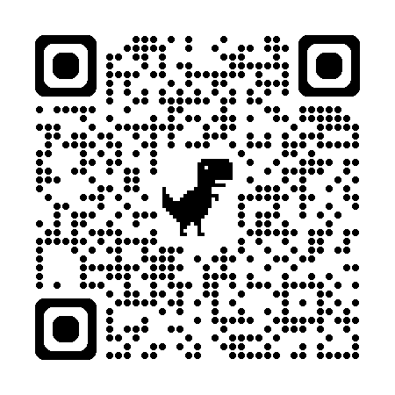
For details To register
A grounding for a life of faith
9-week course
Tuesdays at 7:30pm
Beginning Tuesday 16th September

