Slide 1

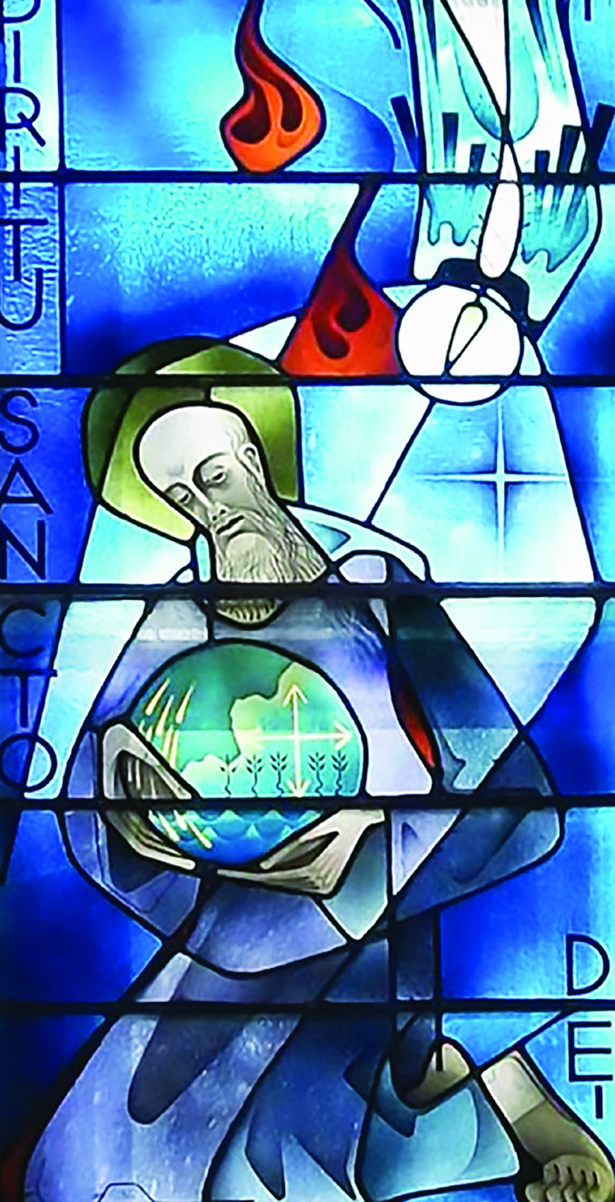
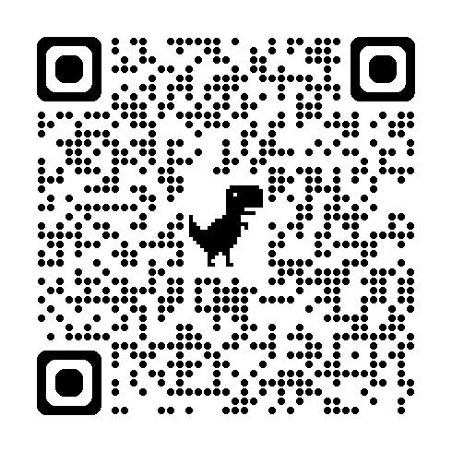
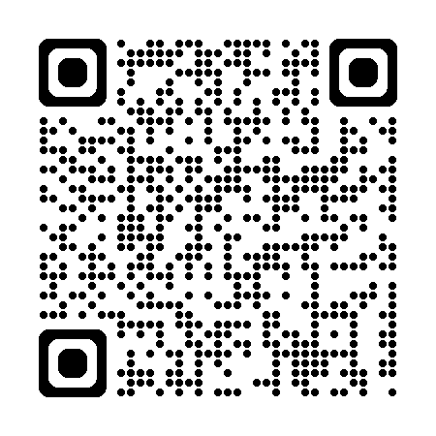
For details To register
The love of learning and the desire for God
The Rule of Benedict as a guide
for parish and community life
6-week course
Thursdays at 7:30pm
Beginning Thursday 18th September

